Slide 1
SMART STUDY PLANNER
CAPSTONE PROJECT
Presented By:
Student Name- Nikita Kumari
College Name- CityEngineeringCollege
Department- Computer Science & Engineering

Slide 2
OUTLINE
Problem Statement
System Development Approach
Algorithm & Deployment
Result
Conclusion
Future Scope
References

Slide 3
Problem Statement
Students often face difficulties in managing their study schedules, tracking tasks, and staying consistent with their learning goals. With multiple subjects, assignments, exams, and deadlines, it becomes difficult to prioritize tasks, track progress, and maintain consistent study habits Traditional methods like notebooks or simple to-do lists lack interactivity, reminders, and progress tracking features, which makes it harder for students to stay productive and motivated.

Slide 4
System Approach
Frontend Technologies:
HTML5 – Used to design the structure of the website, including study schedules, task lists, calendar sections, and reminders. Semantic HTML tags help make the planner accessible and organized.
CSS3 – Provides styling and responsive layouts for the planner. Features like flexbox and grid ensure that the timetable, task cards, and subject lists adapt smoothly across desktops, tablets, and mobile screens.
JavaScript (ES6+) – Adds dynamic functionality such as:
Adding, editing, and deleting tasks or study goals.
Calculating total study hours automatically.
Storing and retrieving user data (e.g., tasks, schedules)

Slide 5
System Approach
Design Approach for Smart Study Planner
Clean and User-Friendly Interface – A distraction-free design with clearly defined sections for timetable, subjects, and goals to help students focus.
Mobile-Responsive Design – The planner adjusts seamlessly across devices so students can check their tasks on-the-go.
Modular File Separation –
HTML file → Structure (tasks, timetable, goals).
CSS file → Styling, theme colors, responsive layouts.
JS file → Core logic for interactivity (adding tasks, reminders, calculations).

Slide 6
Algorithm & Deployment
Task Catalog Creation (for Smart Study Planner)
Define Categories – Tasks and subjects are grouped into categories (e.g., Mathematics, Science, Assignments, Revision, Exams Preparation). This makes it easier for students to manage different areas of study.
Frontend Design:Built with HTML5 + CSS3 & JAVASCRIPT Responsive across devices with simple navigation and color-coded priorities.
Interactive Features:
Add/remove tasks dynamically
Filter by subject
Modal pop-ups for task details
Local storage for saving tasks
Testing:Checked for cross-browser compatibility, mobile responsiveness, functionality correctness, and smooth user experience.
Deployment:Hosted on GitHub Pages

Slide 7
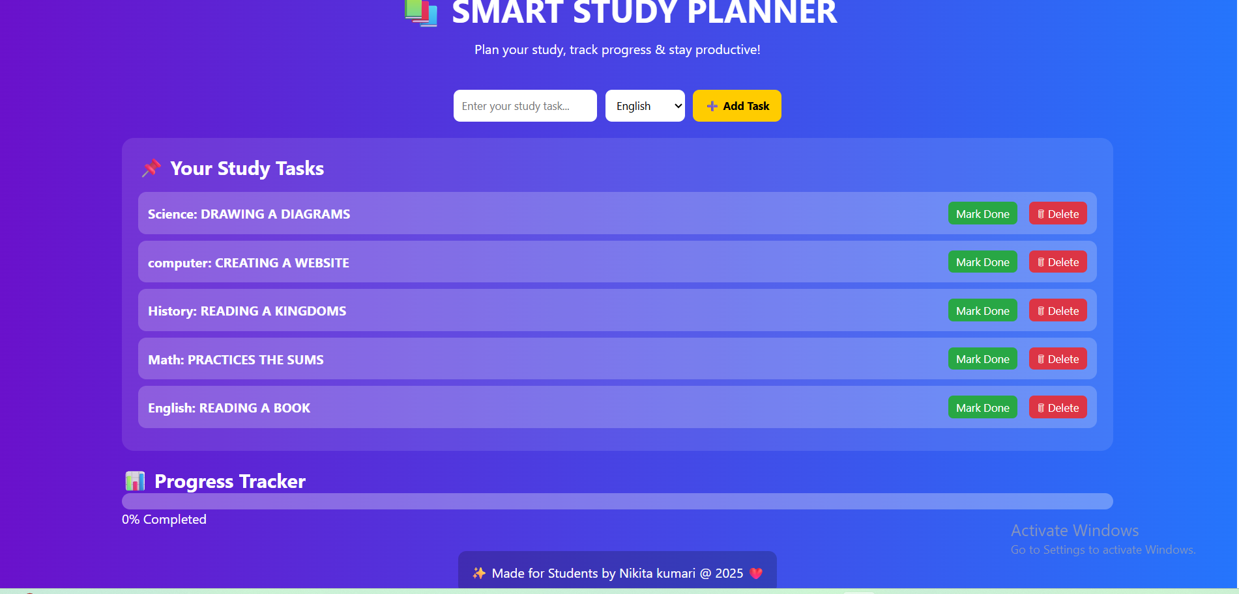
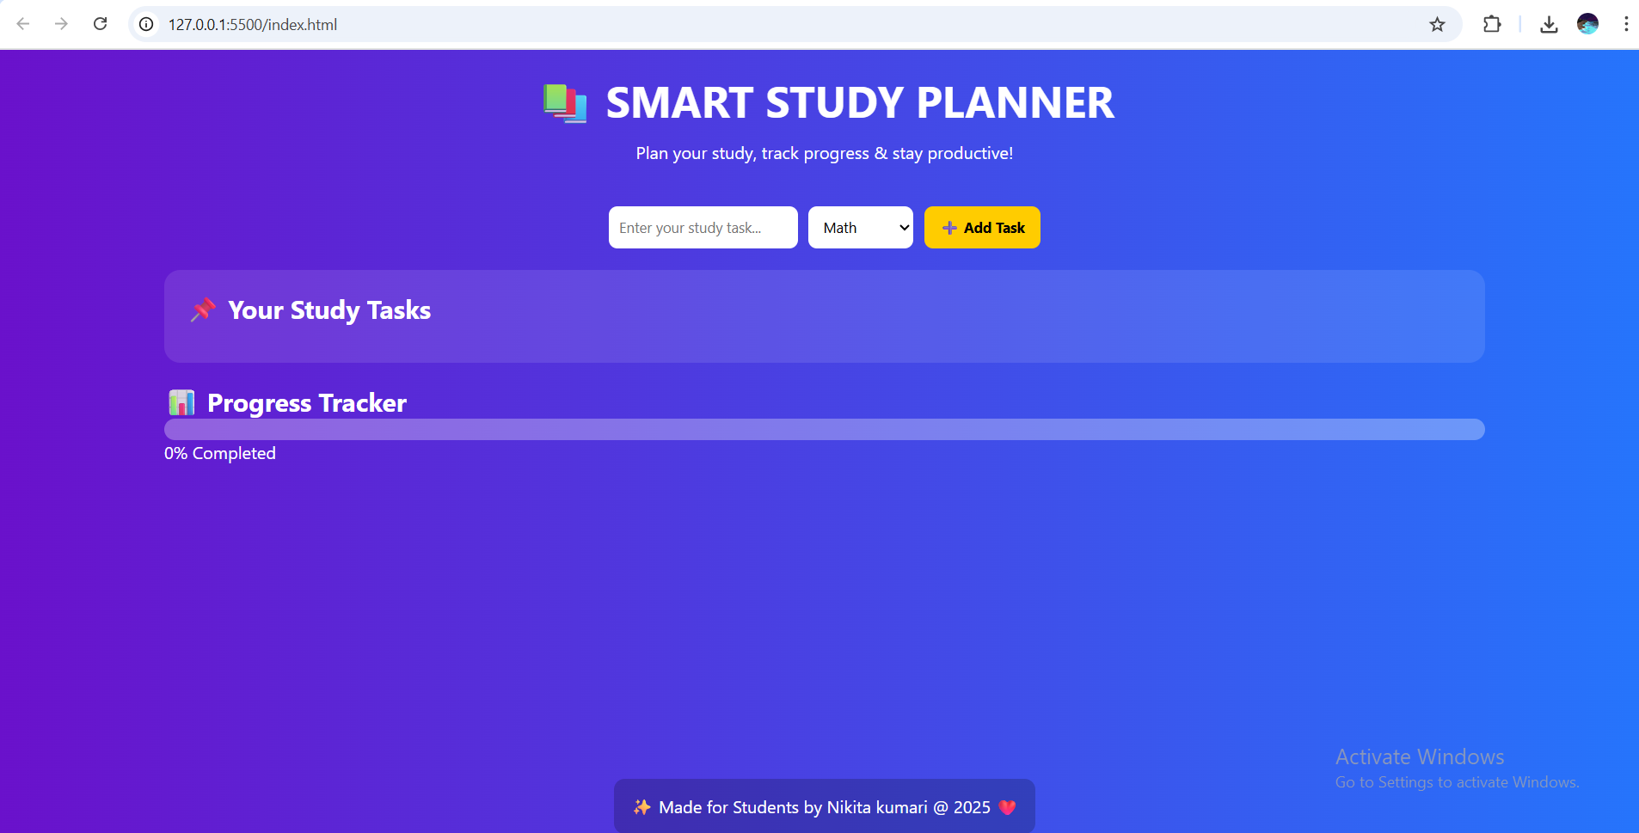
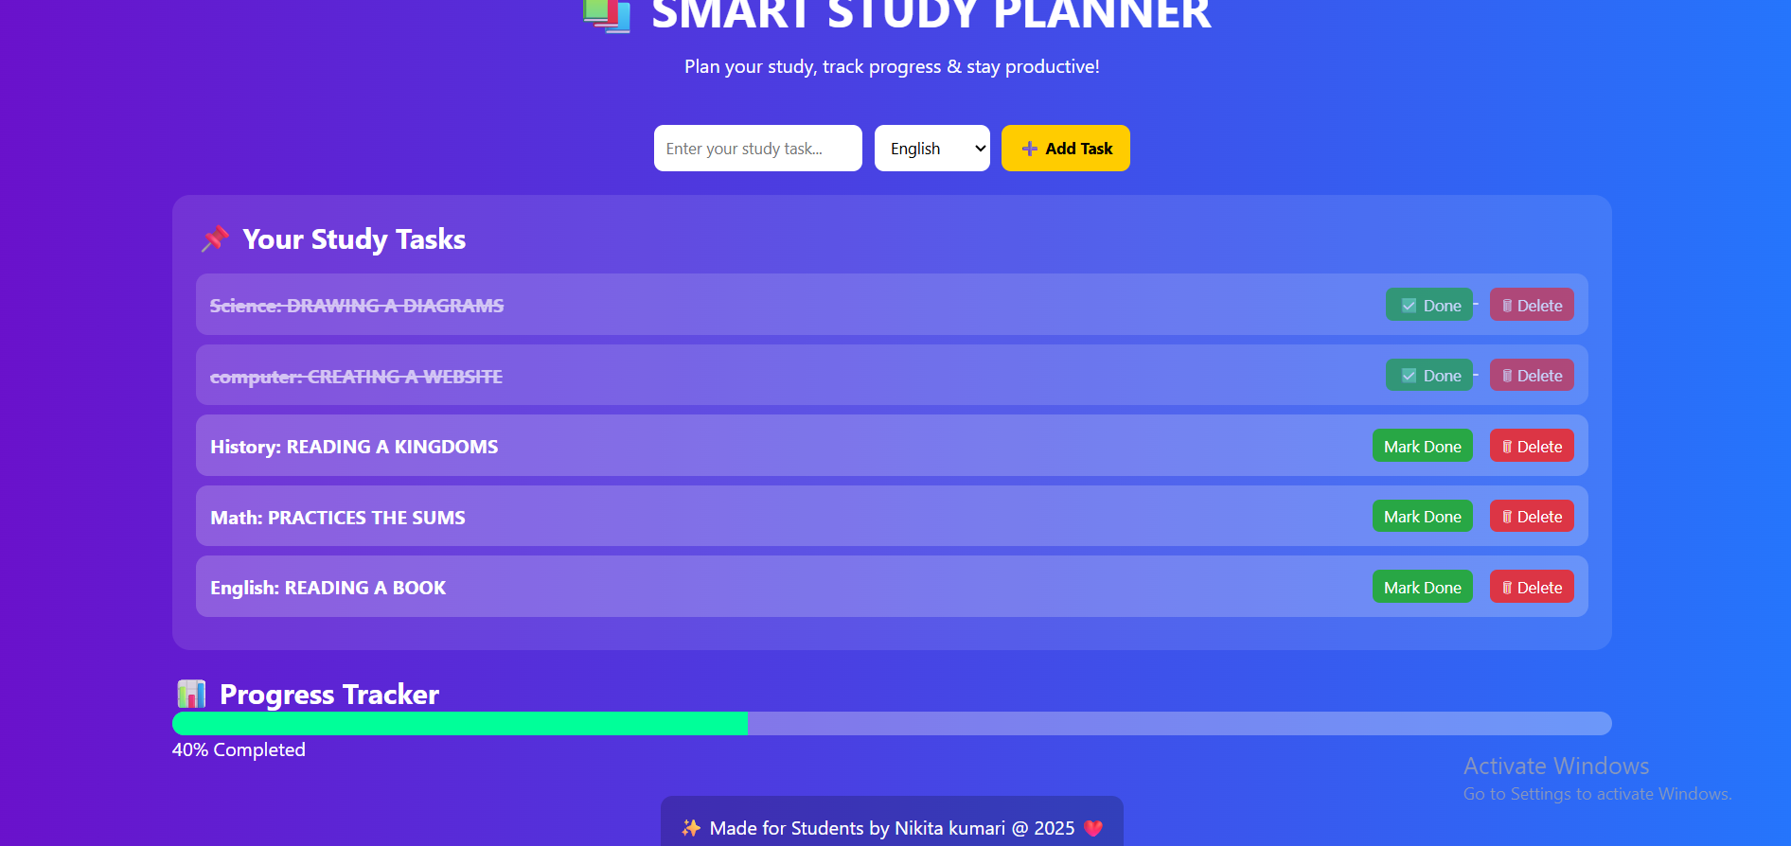
Result

Slide 8
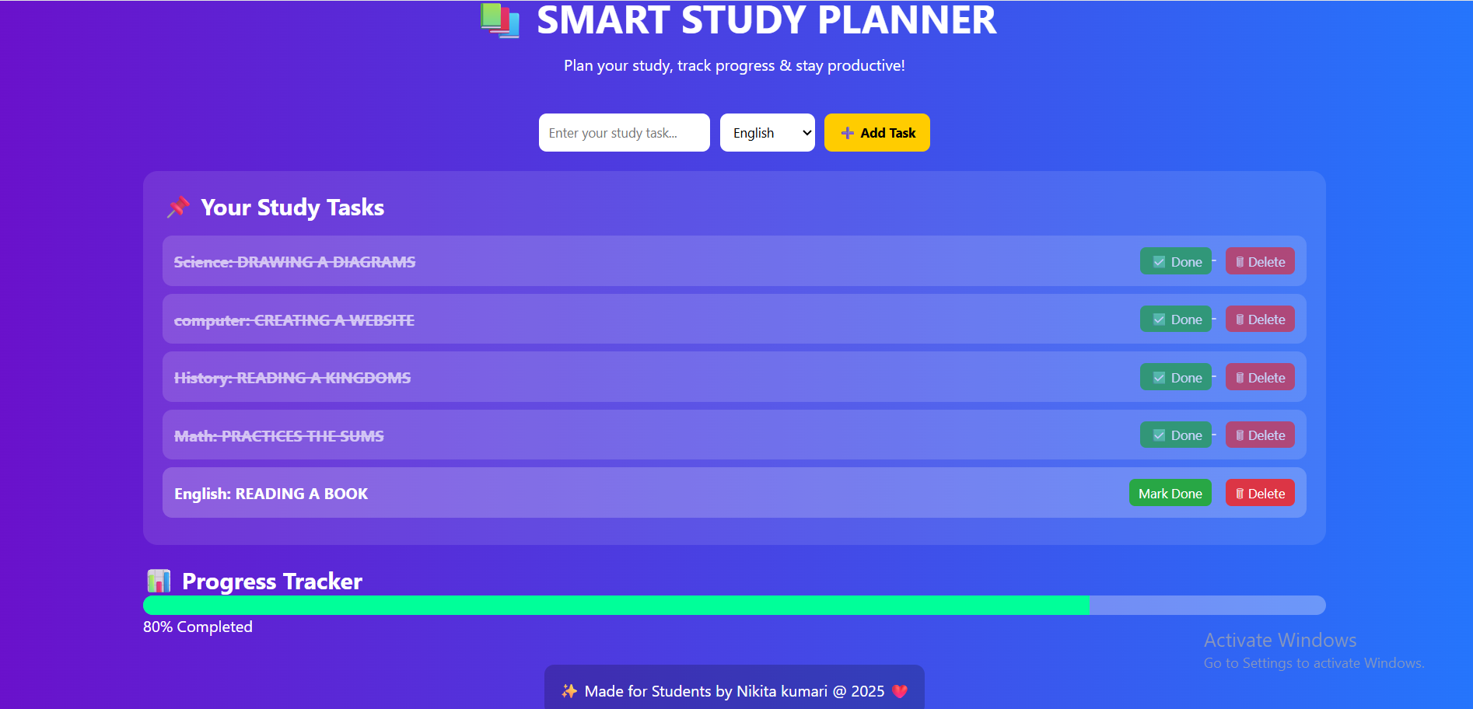
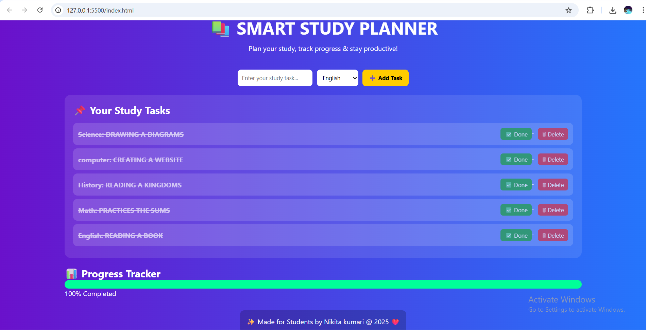
Result
Two task has completed
task has been completed

Slide 9
GITHUB AND DEPLOYMNET LINK
Attach your Github Link :https://github.com/Nikii9036
Deployment link:https://github.com/Nikii9036/Smart-study-planner.git

Slide 10
Conclusion
The Smart Study Planner successfully integrates modern frontend design, interactive features, testing, and deployment into a single platform that simplifies academic planning. By offering a user-friendly interface, real-time task management, and personalized scheduling, it enhances productivity and helps students maintain consistency in their studies. The use of responsive design ensures accessibility across devices, while proper testing and deployment guarantee reliability and scalability. Overall, the Smart Study Planner provides an efficient, innovative, and practical solution to streamline study routines and improve academic outcomes.

Slide 11
Future scope(Optional)
Cross-Platform Synchronization – Enable cloud-based syncing so students can access and update their planner across multiple devices.
Integration with Academic Tools – Connect with online learning platforms, calendars, and assignment portals for automatic task updates.
Analytics & Insights – Provide detailed performance reports and insights to help students identify strengths, weaknesses, and study patterns.
Collaboration Features – Allow group study planning, shared task lists, and peer notifications for collaborative learning.
Smart Notifications & Reminders – Use AI-driven reminders that adjust based on student progress and deadlines.

Slide 12
References
https://www.w3schools.com/html/default.asp
https://www.w3schools.com/css/default.asp
https://www.w3schools.com/js/default.asp
https://codebeautify.org/htmlviewer
https://www.tutorialspoint.com/html/index.htm
https://www.geeksforgeeks.org/html/html-tutorial/
https://www.tutorialspoint.com/css/index.htm
https://www.geeksforgeeks.org/css/css-tutorial/

Slide 13
THANK YOU

